Slide 1
菜单

Slide 2
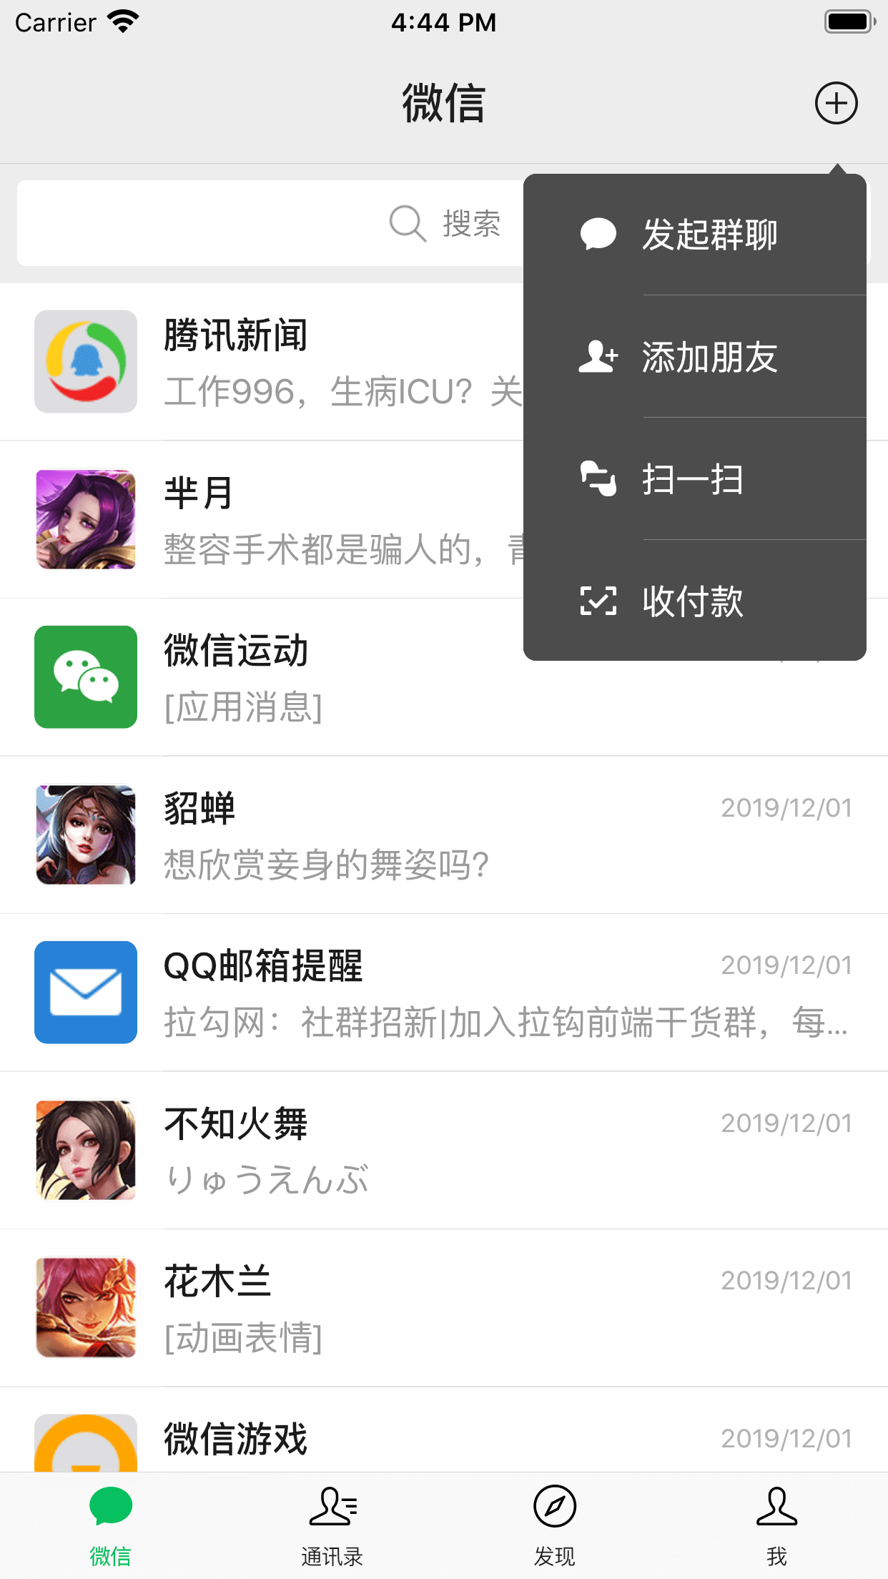

Slide 4
Android UI核心组件

Slide 5
Android UI核心组件
统一、流畅的导航体验

Slide 6
Android UI核心组件
统一、流畅的导航体验
用XML资源定义菜单

Slide 7
用XML资源定义菜单
<?xml version="1.0" encoding="utf-8"?>
<menu
xmlns:android="http://schemas.android.com/apk/res/android">
</menu>

Slide 8
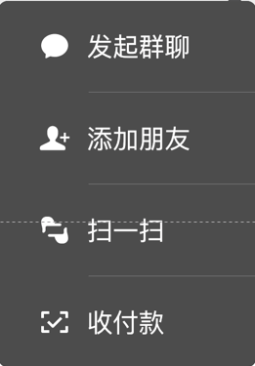
用XML资源定义菜单
@drawable/ic_new_chat
发起群聊
@drawable/ic_add_contact
添加朋友
@drawable/ic_scan
扫一扫
@drawable/ic_money
收付款

Slide 9
<?xml version="1.0" encoding="utf-8"?>
<menu >
<item
android:icon="@drawable/ic_new_chat“
android:title="发起群聊"
/>
<item
android:icon="@drawable/ic_add_contact“
android:title="添加朋友"
/>
<item
android:icon="@drawable/ic_scan“
android:title="扫一扫"
/>
<item
android:icon="@drawable/ic_money“
android:title="收付款"
/>
</menu>

Slide 10
<?xml version="1.0" encoding="utf-8"?>
<menu
xmlns:android="http://schemas.android.com/apk/res/android">
<item
android:id="@+id/new_chat"
android:icon="@drawable/ic_new_chat"
android:title="发起群聊"
/>
<item
android:id="@+id/add_contact"
android:icon="@drawable/ic_add_contact"
android:title="添加朋友"
/>
<item
android:id="@+id/scan"
android:icon="@drawable/ic_scan"
android:title="扫一扫"
/>
<item
android:id="@+id/money"
android:icon="@drawable/ic_money"
android:title="收付款"
/>
</menu>

Slide 11
[演示]

Slide 12
菜单分类

Slide 13
选项菜单

Slide 14
选项菜单
上下文菜单

Slide 15
选项菜单
上下文菜单
弹出菜单

Slide 17
选项菜单

Slide 18
onCreateOptionsMenu()

Slide 19
onCreateOptionsMenu()
onOptionsItemSelected()

Slide 20
onCreateOptionsMenu()
onOptionsItemSelected()
showAsAction="ifRoom"

Slide 21
[演示]

Slide 22
上下文菜单

Slide 23
onCreateContextMenu()

Slide 24
onCreateContextMenu()
registerForContextMenu(view)

Slide 25
[演示]

Slide 26
弹出菜单

Slide 27
PopupMenu(this, anchorView)

Slide 28
PopupMenu(this, anchorView)
setOnMenuItemClickListener

Slide 29
[演示]

